Slide 1
Project 3: Bootstrap - Layouts
Lonnie Goldman

Slide 2
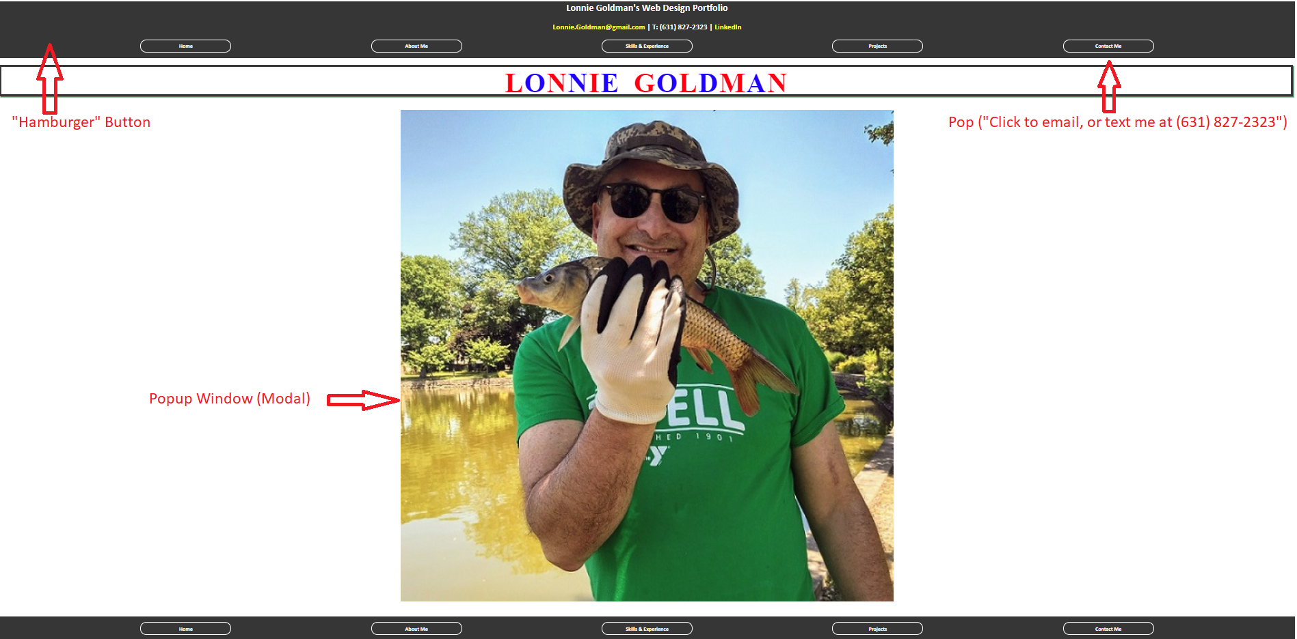
Home (index.html)

Slide 3
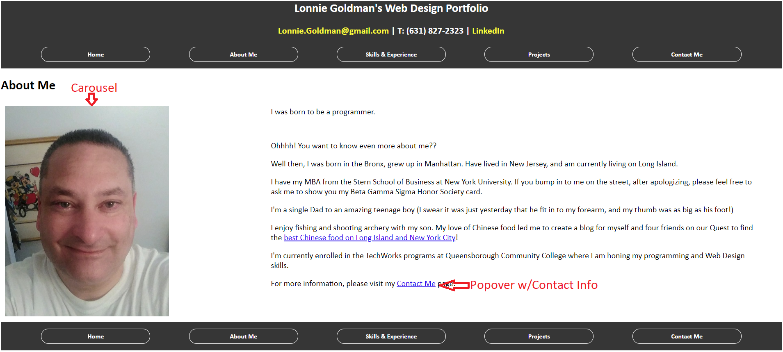
About Me

Slide 4
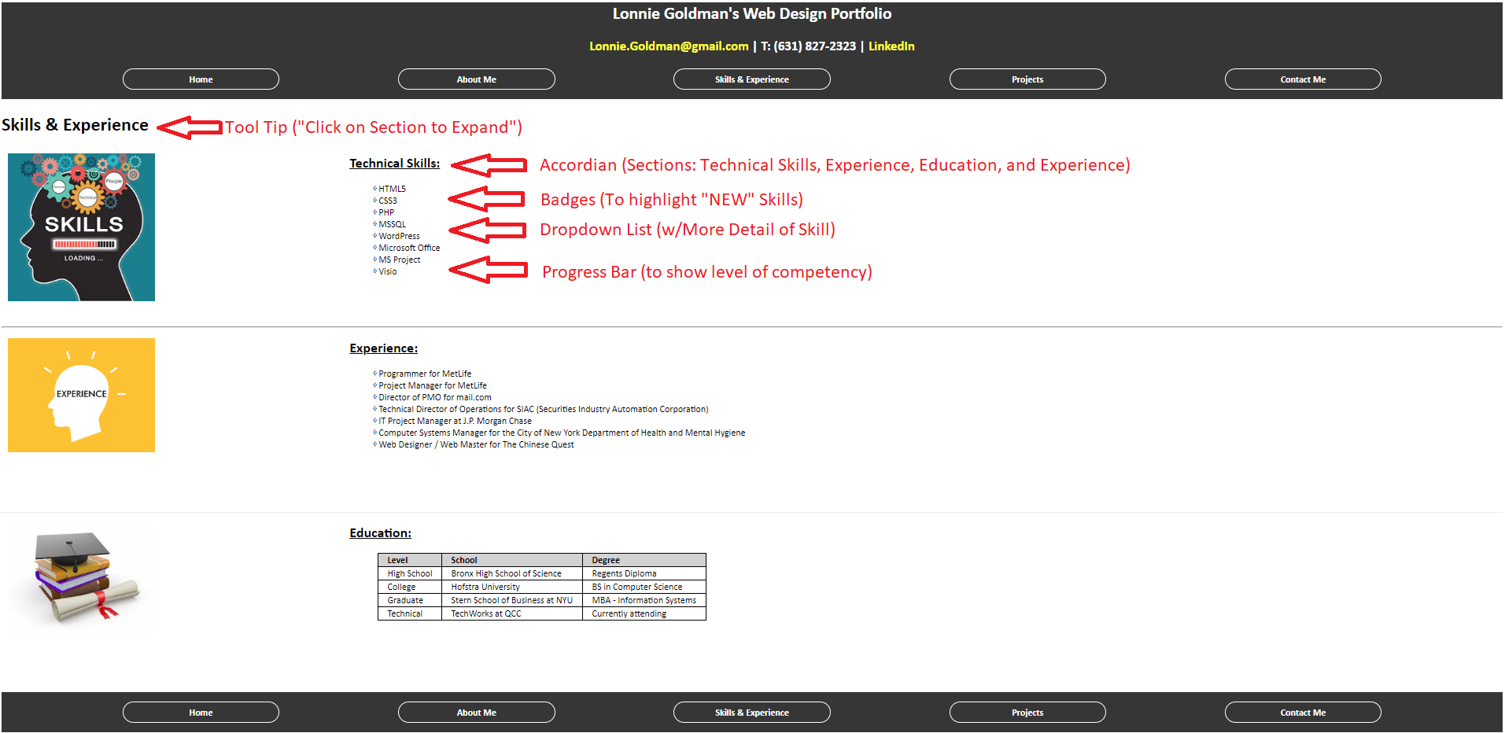
Skills and Experience

Slide 5
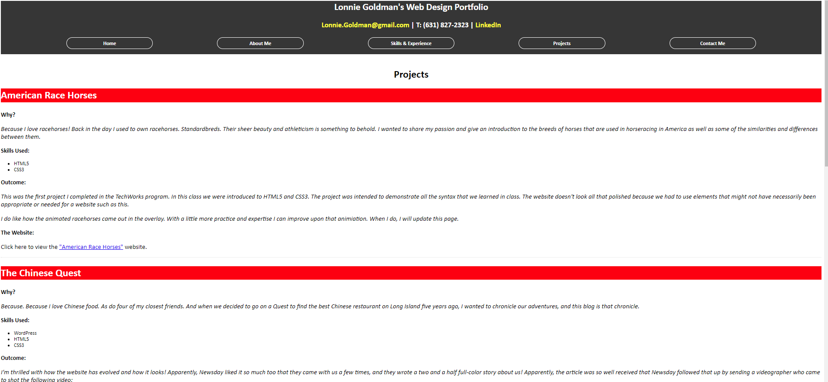
Projects

Slide 6
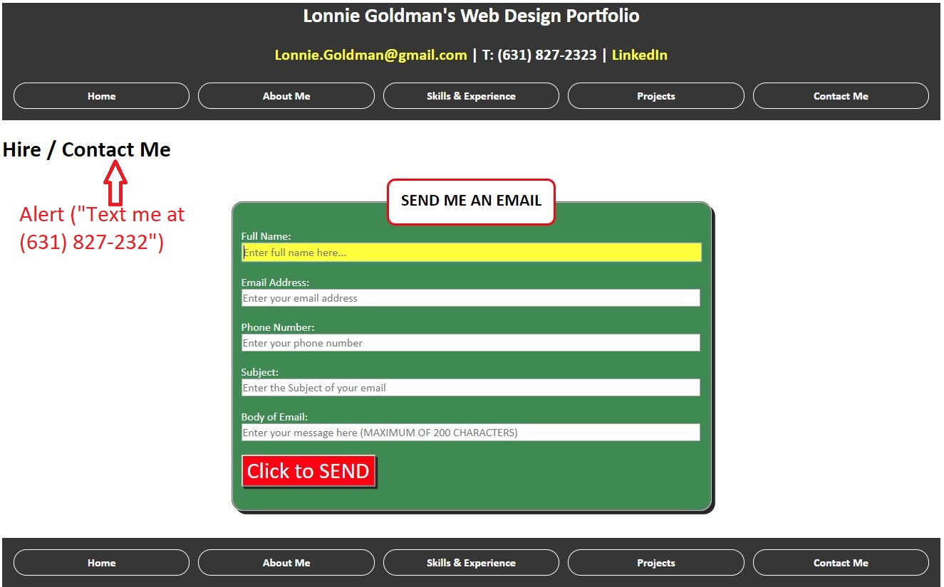
Contact Me

